Slide 1

INTRODUCTION TO MACHINE LEARNING
Machine Learning
Part 1 — What Is Machine Learning? • Part 2 — Supervised & Unsupervised Learning
Lecturer: Dilrabo Khidirova
Notes:
Welcome. Two topics today: what ML is, and the types of ML problems. Set an interactive tone from the first minute.

Slide 2
ROADMAP
What we'll cover today
01
The Big Flip
02
Core vocabulary
how ML differs from traditional programming
model, dataset, instance, feature, target
03
AI vs ML
04
Supervised types
how they nest together
classification vs regression
05
Unsupervised types
06
Case study
clustering, dim. reduction, anomaly
framing a real business problem
Introduction to Machine Learning
2
Notes:
Promise interactivity: polls, sorting games, and a breakout case study.

Slide 3
PART 1
What Is Machine Learning?
Teaching a computer WHAT to do — without telling it HOW.
Notes:
Part 1 recaps the foundation; keep it brisk if students are confident.

Slide 4
CORE IDEA
The Big Flip
Traditional programming
Machine learning
You write the rule by hand.
The machine learns the rule from examples.
if area > 80 and rooms ≥ 3 → "expensive"
show 10,000 sold houses → learn the pattern
RULES + DATA → ANSWERS
DATA + ANSWERS → RULES
How does a child learn "cat"?
No parent recites rules about whiskers — they point: "cat… cat… that's a dog." After enough labelled examples, the child learns the pattern. Machine learning learns the same way. The rule it produces is called a MODEL.
Introduction to Machine Learning
4
Notes:
This is THE idea of the lesson. Point at each card. The learned rule = model.

Slide 5
JUDGEMENT
When ML shines — and when it doesn't
✓ Reach for ML when…
✕ Skip ML when…
Repetitive patterns
Exact known rule
the signal is in the data (spam, buying habits)
tax, sorting, unit conversion → just code it
Scale
Catastrophic errors
millions of cheap predictions a human can't make
unexplainable high-stakes output with no safeguard
Error-tolerant
No data
an occasional wrong answer is acceptable
no data → nothing to learn from
Changing world
fixed rules rot; retrain the model
Introduction to Machine Learning
5
Notes:
Knowing when NOT to use ML separates an engineer from a hype-follower.

Slide 6
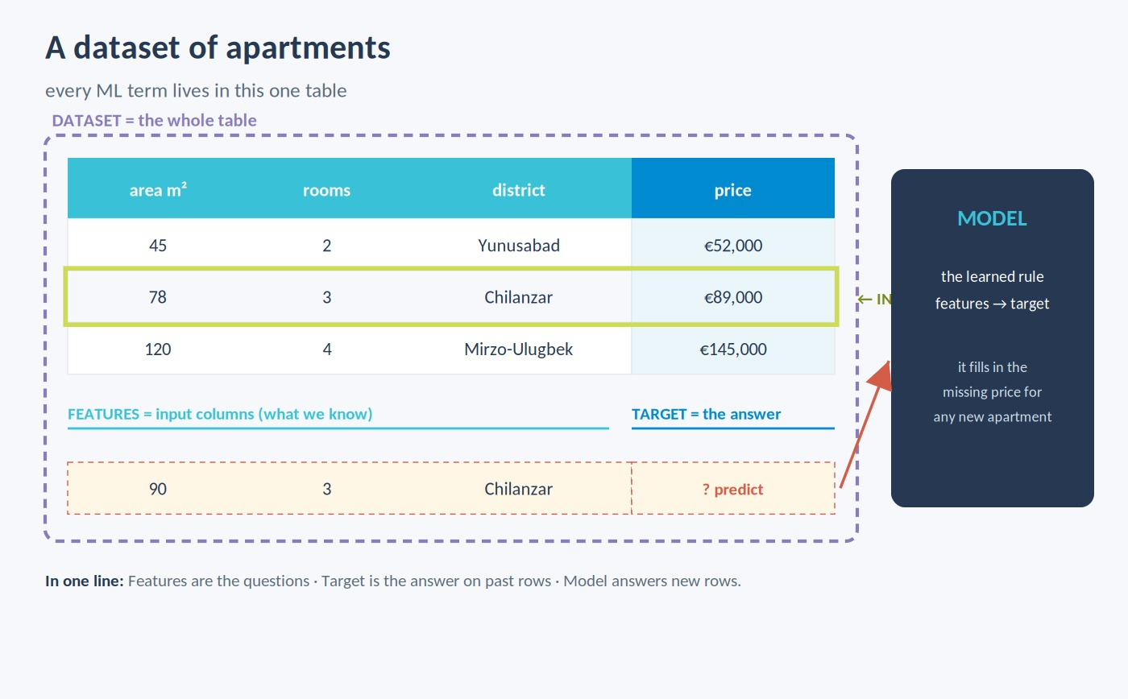
LANGUAGE OF ML
Core vocabulary in one picture
Dataset
all the examples
Instance
one row / example
Feature
an input column
Target
the answer to predict
Model
the learned rule
Introduction to Machine Learning
6
Notes:
Features = questions we ask; target = the answer on past examples; model = the cheat-sheet.

Slide 7
THE MAP
Three families of machine learning
Supervised
Unsupervised
Reinforcement
"learns from an ANSWER KEY"
"finds patterns, NO answer key"
"learns from REWARDS, by doing"
labelled data → spam, price
segments, anomalies
game agents, robots
Introduction to Machine Learning
7
Notes:
One-liners: answer key / no answer key / rewards. Students reuse these all lesson.

Slide 8
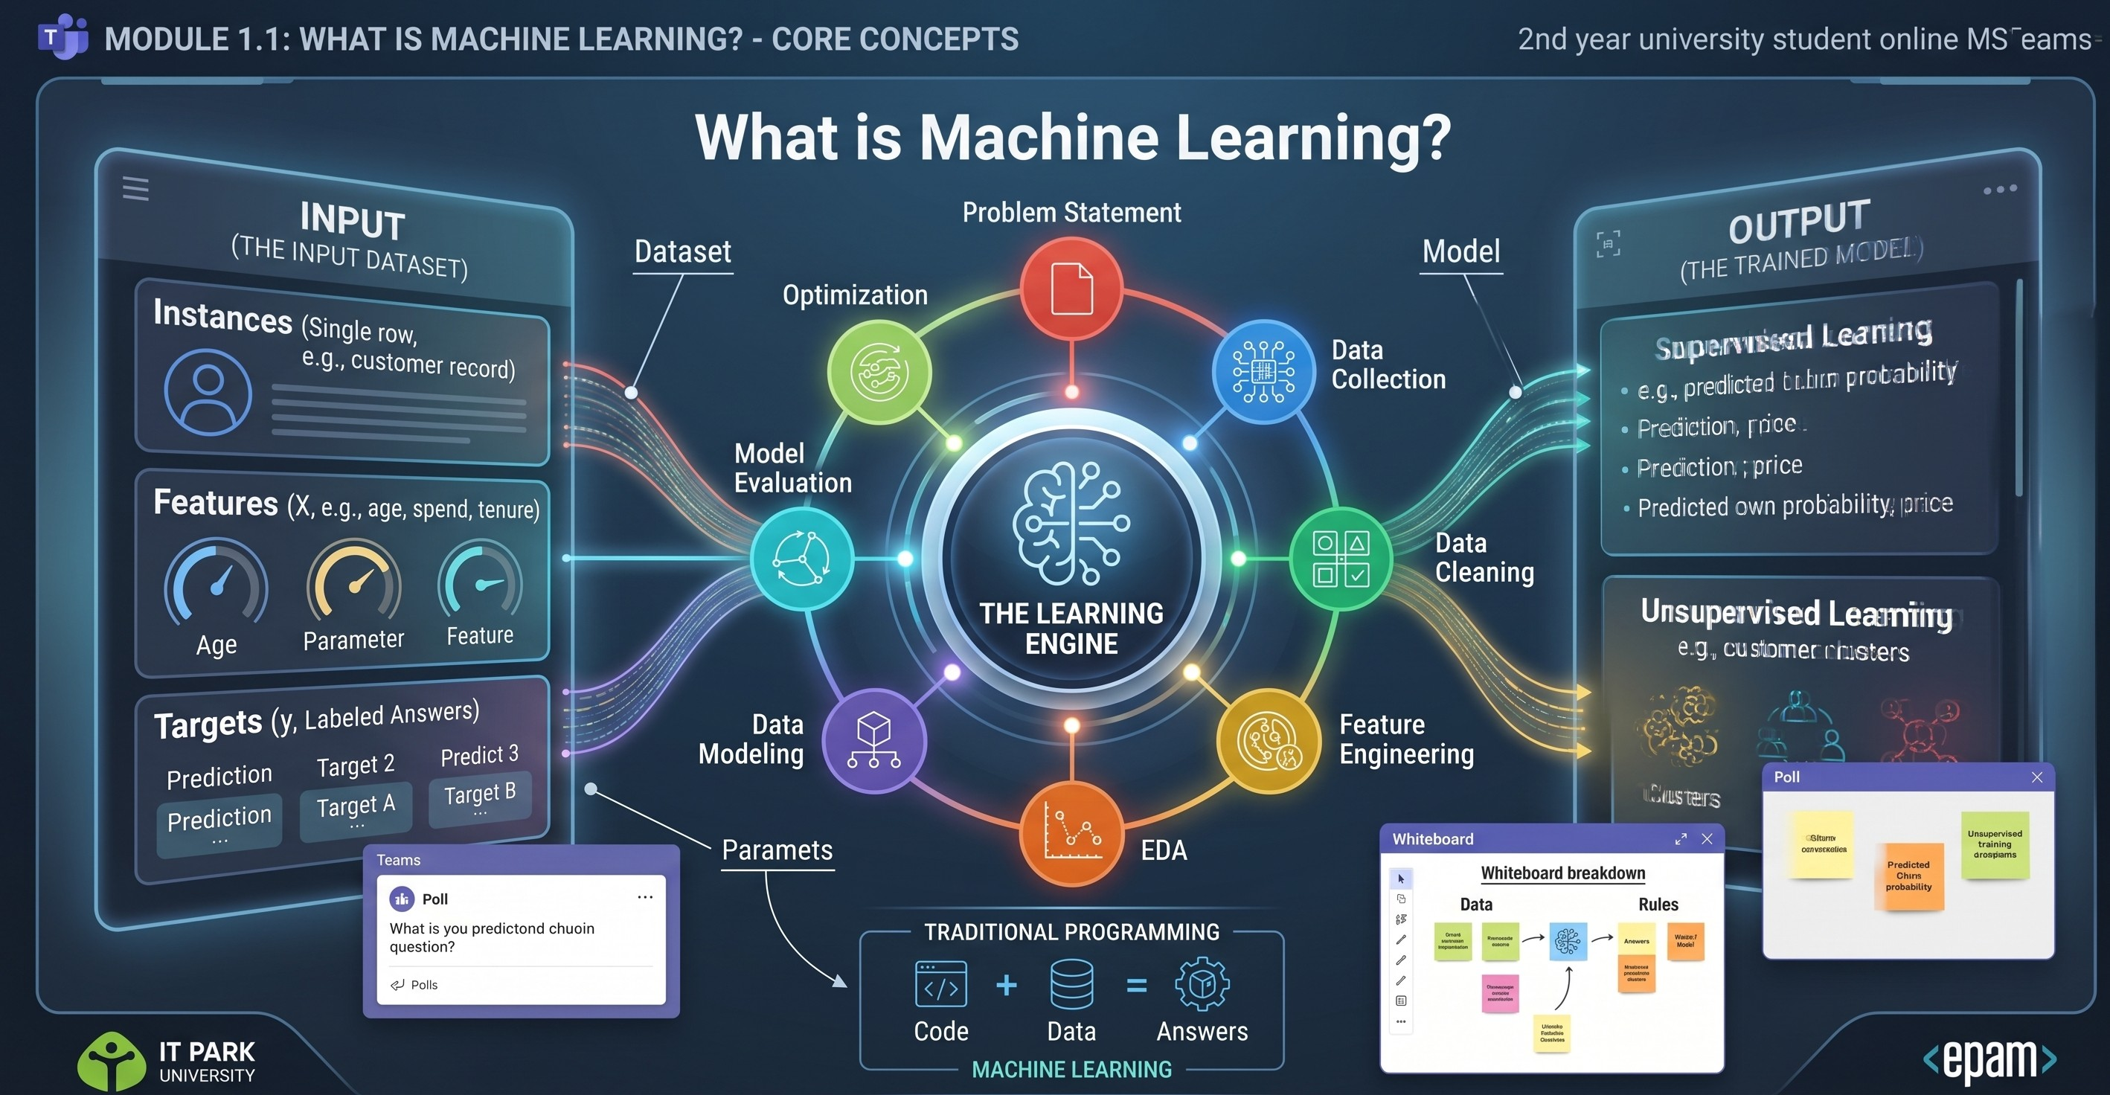
RELATIONSHIP
AI vs ML — how they nest
The nesting rule
AI
any machine acting "smart", incl. hand-coded rules
ML
the subset that LEARNS from data
Deep learning
ML built on neural networks
All ML is AI — but not all AI is ML.
Introduction to Machine Learning
8
Notes:
Thermostat = AI not ML; spam filter = ML; calculator = neither.

Slide 9
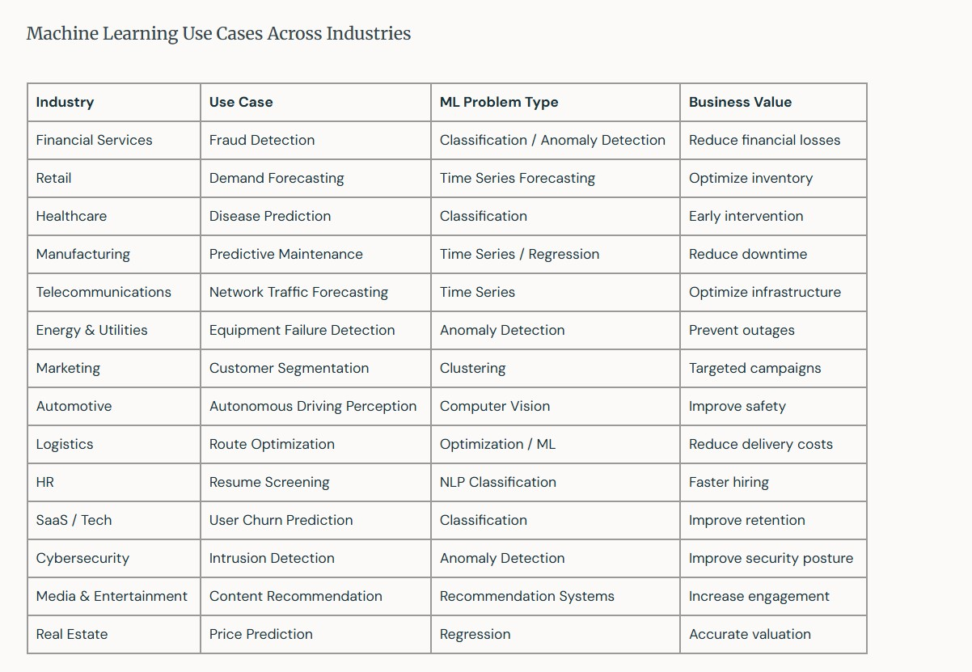
WHY IT MATTERS
Machine learning across industries
Introduction to Machine Learning
9
Notes:
Every row is a real ML job. Naming the problem type correctly is the first engineering decision.

Slide 10
PART 2
Supervised & Unsupervised Learning
Notes:
Part 2 is the heart of Lesson 2 — the problem-type taxonomy.

Slide 11
FAMILY 1
Supervised learning — has an answer key
Learning from labelled examples — the data comes with the right answers. The model studies past cases, then answers new ones.
Two problem types live here:
CLASSIFICATION
predict a category
Remember from Lesson 1
REGRESSION
predict a number
Supervised = "studying with a solved answer key." Every example already carries its correct label, so the machine has something to check itself against.
Introduction to Machine Learning
11
Notes:
Anchor to Lesson 1's answer-key story before splitting into the two types.

Slide 12
SUPERVISED TYPES
Classification vs Regression
📥 Classification
📈 Regression
Predicts
a category / label
Predicts
a number on a scale
Analogy
sorting mail into bins
Analogy
reading a value off a dial
Examples
spam / not-spam, disease / no-disease, churn yes / no
Examples
house price, temperature, sales, delivery ETA
Answer
one of a few fixed options
Answer
any value in a range
Introduction to Machine Learning
12
Notes:
Engaging question: give me one classification and one regression problem from your life.

Slide 13
SEE THE DIFFERENCE
Boundary vs line
Classification — splitting categories
Regression — predicting a number
Same-style data, two different questions: a boundary that separates categories vs a line that predicts a value.
Introduction to Machine Learning
13
Notes:
Tie to the interactive playground: flip the toggle, same dots, boundary vs line.

Slide 14
FAMILY 2
Unsupervised learning — no answer key
Finding patterns in data with no labels — you discover the structure yourself. There is no "right answer" to check against.
Three problem types live here:
CLUSTERING (main)
group similar items
Contrast with supervised
DIM. REDUCTION
many features → a few
Supervised has the answers and learns to reproduce them. Unsupervised has none — it invents structure from the data alone.
ANOMALY DETECTION
flag the odd one out
Introduction to Machine Learning
14
Notes:
Spend the most time on clustering — it's the workhorse.

Slide 15
UNSUPERVISED TYPES
Clustering · Dimensionality reduction · Anomaly detection
Clustering
Dimensionality
reduction
Anomaly
detection
THE MAIN ONE
What it does
What it does
What it does
groups similar items, no labels
compresses many features into a few
flags the rare / odd item out
Analogy
Analogy
Analogy
sorting a photo library into look-alike piles
a 50-question survey summed into 3 themes
the one fake note in a stack of real ones
Examples
Examples
Examples
customer segments, grouping articles
visualisation, compression, denoising
fraud detection, defect spotting
Introduction to Machine Learning
15
Notes:
Engaging question: give an example of each. Prioritise clustering answers.

Slide 16
SPECIAL CASES
Problems that don't fit neatly
Recommender systems
"People like you also liked…"
Examples Netflix, YouTube, e-commerce
Predict what a user will want. Can be framed supervised (will-buy?) or unsupervised (similar users). NOT a 4th family — it's built from the parts we named.
Time-series analysis
Data ordered in time
Examples demand forecasting, temperature, server load
Predict the next value(s). The ORDER carries the signal — unlike a normal table you can shuffle.
Introduction to Machine Learning
16
Notes:
Recommenders = application, not a family. Time-series = order matters.

Slide 17
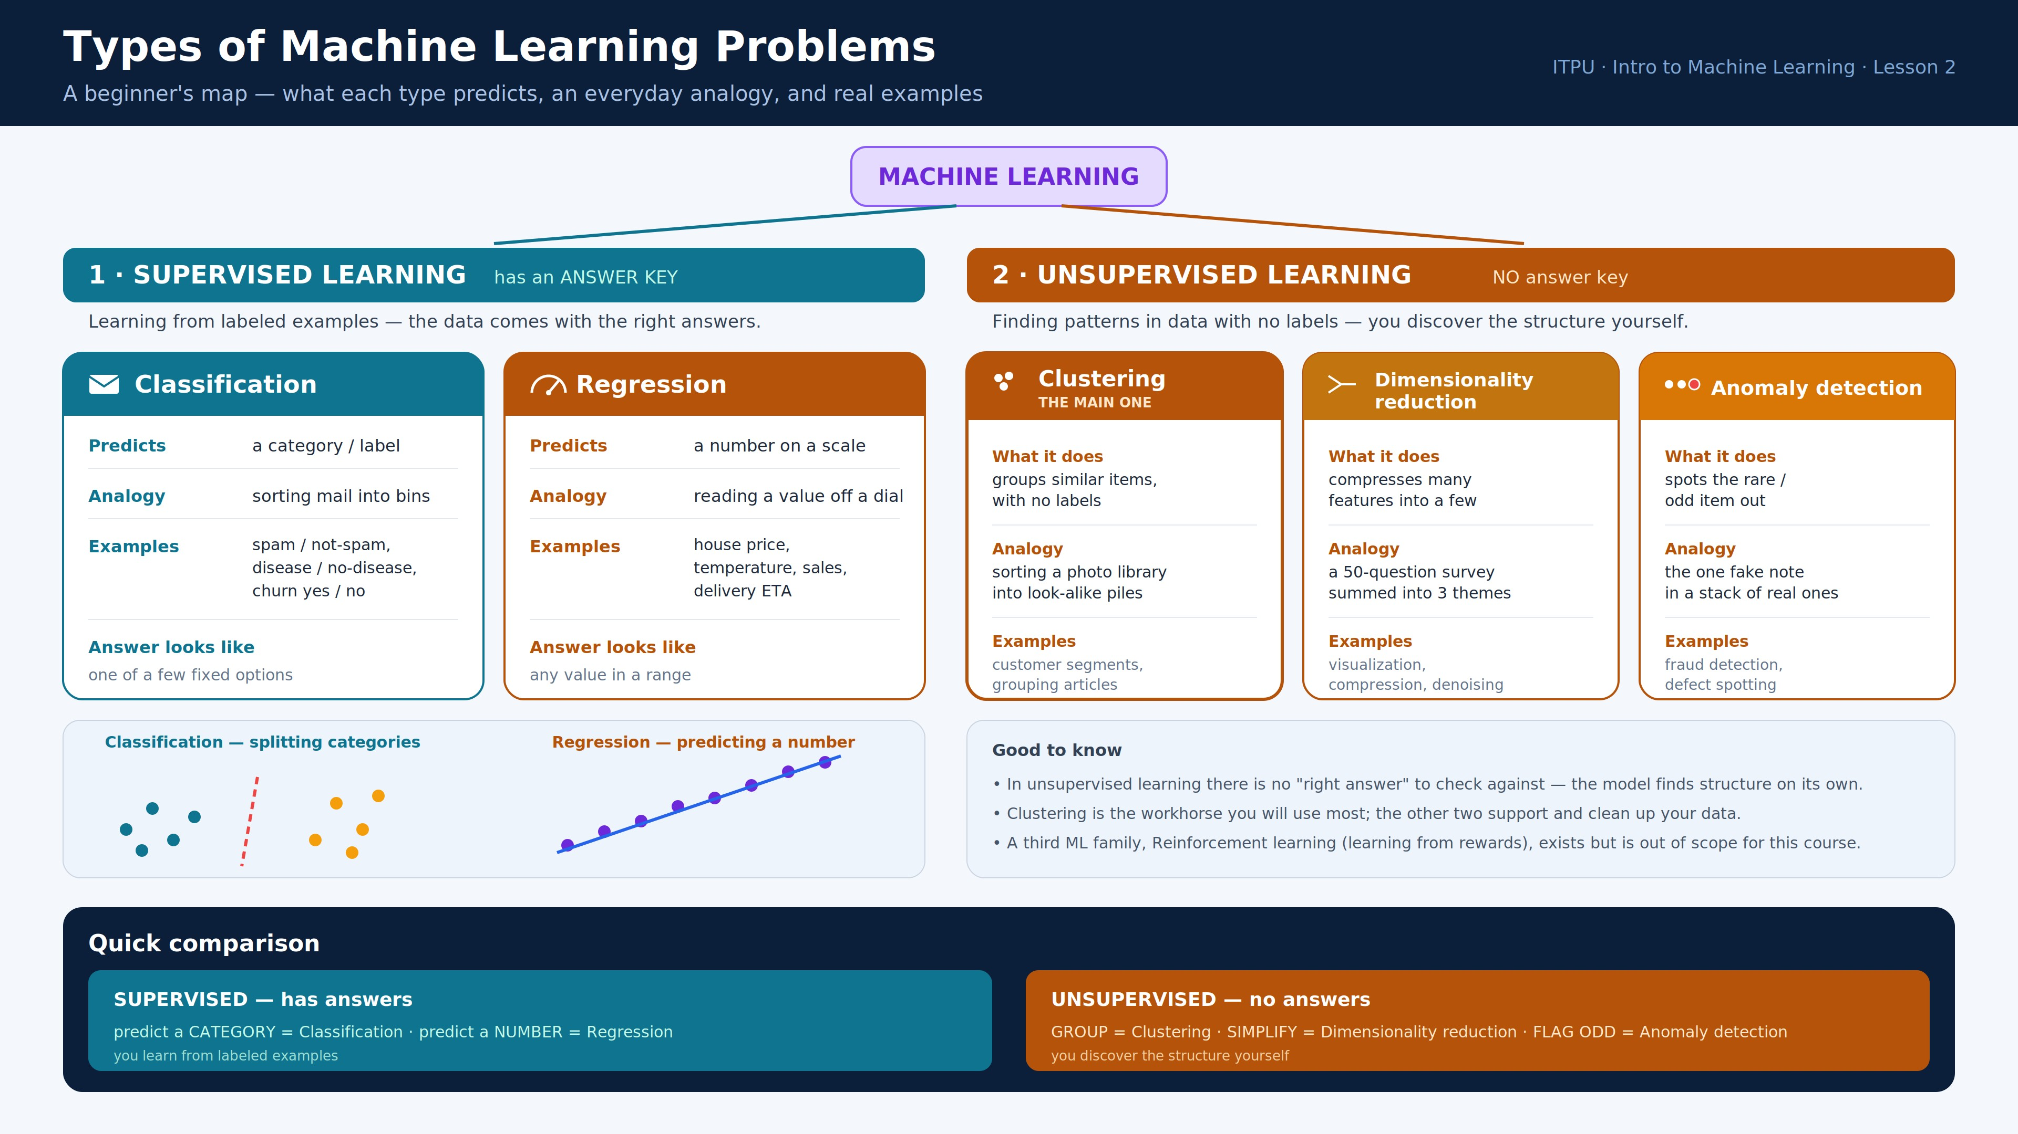
ONE-PAGE MAP
The five problem types at a glance
Introduction to Machine Learning
17
Notes:
Give students this as their reference card. Everything on one page.

Slide 18
APPLY IT
Case study — StreamNest
A music-and-video platform needs TWO systems: (1) segment users for marketing, and (2) forecast next-week demand so servers don't crash. Frame each before any code.
① Segment the users
② Forecast demand
Problem type
Unsupervised · clustering
Problem type
Time-series (regression-style)
Labels?
none — invent the groups
Signal
past values in time order
Features
listening habits, genres, sessions
Features
past streams, seasonality, releases
Main risk
clusters may not be meaningful
Main risk
order matters — don't shuffle
Introduction to Machine Learning
18
Notes:
Run as breakout rooms. Trap: teams calling segmentation 'classification' — ask what the labels are. There are none.

Slide 19
WATCH OUT
Common pitfalls that sink real projects
⚠
Calling clustering "classification"
if there are no labels, you can't classify — you cluster
⚠
Shuffling a time-series
order carries the signal; shuffling destroys it
⚠
Forcing recommenders into one bucket
frame the sub-question: will-buy? = classification; similar-users = clustering
⚠
Over-reducing dimensions
compress too far and you throw away the pattern you needed
Introduction to Machine Learning
19
Notes:
Naming the problem type correctly is the first real engineering decision — it decides everything after.

Slide 20
Key takeaways
1
ML learns rules from data + answers — not rules you write by hand
Next
We start on the first algorithm — Regression: how a model fits that line to the data.
2
Supervised = answer key — classification (category) · regression (number)
3
Unsupervised = no answer key — clustering · dimensionality reduction · anomaly detection
4
Framing comes first — name the problem type before choosing an algorithm
Thank you!
Notes:
Ask students to state the recap lines. Exit ticket: learned / understood / can apply / still unanswered.

